Slide 1

Vehicle Route Optimization
Team Member:
SrinathVissarapu
Mentor:
Dr.JaswanthNidamanuri

Slide 2

Problem Statement
The customer has multiple trucks, and each truck will be assigned certain spots daily to collect the garbage. The goal of the project is to generate an optimized route for the garbage collection vehicle. Sometimes a new spot will come up at random and the route needs to be optimized accordingly

Slide 3

Contents
Domain Challenges
Architecture Diagram
Technology Stack
Component Diagram
Components
Model
Literature Review
Results and analysis

Slide 4
Domain challenges
Company limitations
Minimum number of sites
Maximum number of sites
Days of the week
Holidays
Distance
Day/Night
Vehicle considerations
Vehicle Size type
Waste Type – Liquid, solid, semi solid, Chemical Waste
Mileage of the vehicle per km
Maximum speed of the vehicle

Slide 5
Monetary Conditions
Trip allowance
Revenue Generated from site
Vehicle Maintenance cost per trip
Tall roads
Locality conditions
Speed limits – Day/Night
Number of Km driven per day
Pickup site conditions
Site timings
Site limitations
Site RFID
Customer Type
Priority customer
Big customer

Slide 6
Dynamic considerations
Dynamic sites
Vehicle Breakdown
Avg.speed
Excess Baggage
Weather
Special customer request
Personal leave
Huge rush of orders
Order cancellation at last minute

Slide 7
Architecture Diagram

Slide 8
Technology Stack
Programming languages: Python.
Optimization Libraries: There are several optimization libraries available for these programming languages, such as PuLP, Gurobi.
Geographic Information Systems (GIS): GIS technologies such as OpenStreetMap, ArcGIS, and Bing Maps can be used to store and visualize location data.
Routing Engines: Routing engines like OSRM (Open-Source Routing Machine) and GraphHopper can be used to calculate the most efficient routes for vehicles
Cloud Platforms: Cloud platforms like Amazon Web Services (AWS) and Microsoft Azure can be used to deploy and scale the solution.
Data Storage: Databases like MySQL, and MongoDB can be used to store and retrieve data related to vehicles, customers, and routes.
Visualization Tools: Visualization tools such as Tableau and PowerBI can be used to create visual dashboards to monitor and analyze the optimization results.
Machine Learning: Machine learning algorithms can be used to improve the accuracy of the optimization results, by predicting traffic conditions or customer demand.
Notes:
callback_index: The index for the callback that returns the quantity. The index, which is the solver's internal reference to the callback, is created by methods such as RegisterTransitCallback or RegisterUnitaryTransitCallback.slack_max: Maximum for the slack, a variable used to represent waiting times at the locations. See slack variables below for details. If the problem doesn't involve waiting time, you can usually set slack_max to 0.capacity: Maximum for the total quantity accumulated along each route. Use capacity to create constraints like those in the CVRP. If your problem doesn't have such a constraint, you can set capacity to a value that is sufficiently large to impose no restrictions on the routes —for example, the sum of all entries of the matrix or array used to define the callback.fix_start_cumulative_to_zero: Boolean value. If true, the cumulative value of the quantity starts at 0. In most cases, this should be set to True. However, for the VRPTW or problems with resource constraints, some vehicles may have to start after time 0 due to time window constraints, so you should set fix_start_cumulative_to_zero to False for these problems.dimension_name: String for the name for the dimension, such as 'Distance', which you can use to access the variables elsewhere in the program.

Slide 9
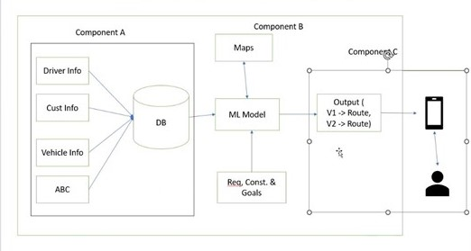
Component Diagram

Slide 10
Components
DataBase - Storage [A]
Model- Train based on data acquired from online source

Slide 11
ML ALGORITHMS
Ant Colony Optimization: This algorithm is inspired by the behavior of ant colonies. The algorithm can be used to find the shortest route for waste collection by assigning pheromone values to the edges of the graph representing the road network.
Genetic Algorithm: genetic algorithms can be used to find the optimal route for a vehicle to travel between multiple destinations while minimizing the distance traveled or time taken.
Adding custom constraint to OR tools : Using pywrapcp Model

Slide 12
Allocation of solid waste collection bins and route optimization using geographical information system
-by D Khan and SR Samadder
➔This reference paper is a case study that gives detailed information about how route optimization is done by getting data through geographical information systems.
➔Data Collection:
Collected data through ward maps, topographical maps, census reports, etc. were collected and a base map was prepared which was furtherly converted and integrated into GIS format.
➔Bins allocated:
choosing appropriate locations of solid waste collection bins and their capacities are the prime focus of a solid waste management strategy.

Slide 13
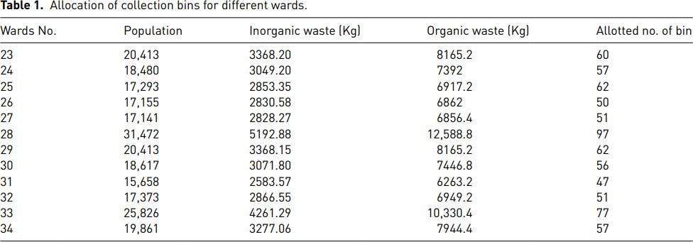
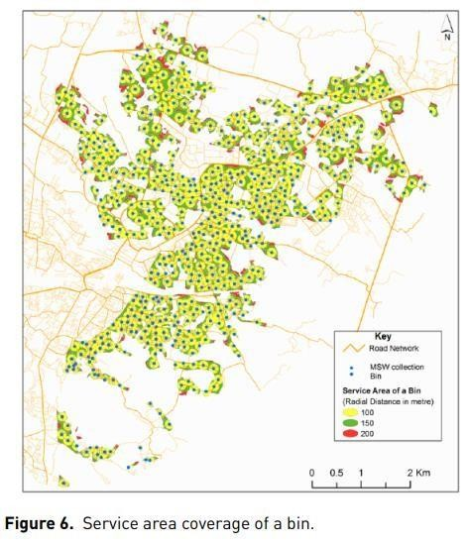
Location of bins and their optimized routes

Slide 14
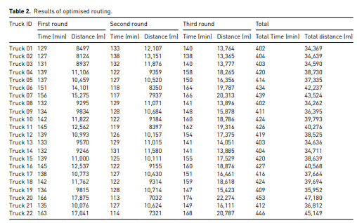
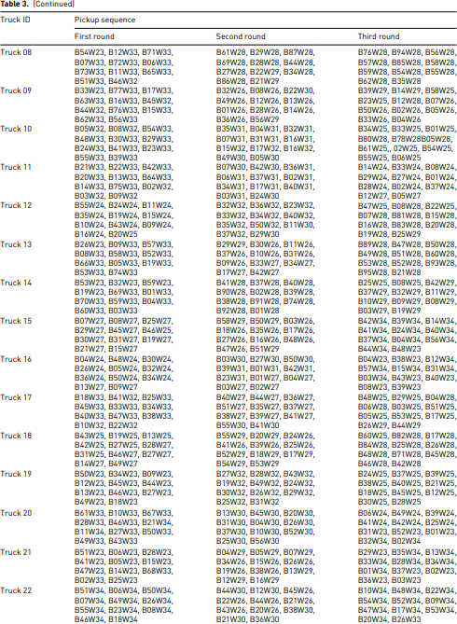
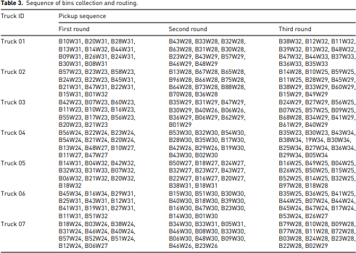
Jcm

Slide 15
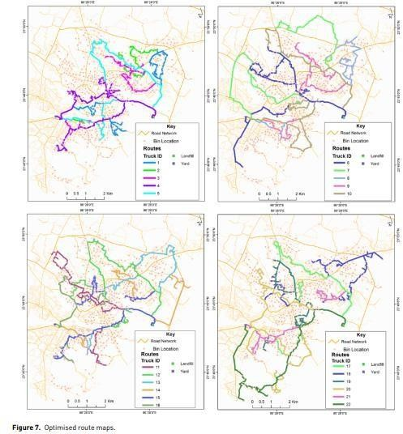
Conclusion:-
The VRP solver was used for routing as it considers all of the most critical functional requirements, such as vehicle capacity, pickup capacity, service time, and break time.
Reference:-
Allocation of solid waste collection bins and route optimisation using geographical information system: A case study of Dhanbad City, India (researchgate.net)

Slide 16
Benchmark dataset for multi depot vehicle routing problem with road capacity and damage road consideration for humanitarian operation in critical supply delivery
Overview: The multi-depot vehicle routing problem (MDVRP) with road capacity and damaged road consideration is a significant challenge in humanitarian operations, specifically in critical supply delivery. This problem involves determining optimal routes for multiple vehicles from multiple depots to serve a set of customers while considering road capacity constraints and the presence of damaged roads. The objective is to minimize the total distance traveled or maximize the number of served customers while adhering to these constraints.
Benchmark Dataset: Creating a benchmark dataset for MDVRP with road capacity and damaged road consideration is crucial for evaluating and comparing the performance of various routing algorithms and heuristics. The dataset should consist of information such as depot locations, customer locations, road networks with capacity information, and the extent of damage on each road segment.
The dataset should also include relevant parameters such as vehicle capacities, customer demands, vehicle operating costs, and the severity of road damage. Real-world data from humanitarian operations can be utilized to reflect the complexities and challenges faced in practical scenarios.

Slide 17
Conclusion: The MDVRP with road capacity and damaged road consideration poses a significant challenge in humanitarian operations for critical supply delivery. Creating a benchmark dataset that reflects the complexities of real-world scenarios is crucial for evaluating and comparing different routing algorithms and heuristics.
Further research can focus on developing more sophisticated algorithms that consider additional factors, such as uncertain customer demands, dynamic road conditions, and time-dependent road capacity. Additionally, incorporating real-time data and leveraging emerging technologies, such as machine learning and predictive analytics, could enhance the efficiency and effectiveness of routing solutions for humanitarian supply delivery in critical operations.
Dataset : https://data.mendeley.com/datasets/nt6j9c8653/2
Link : https://www.sciencedirect.com/science/article/pii/S2352340922001135

Slide 18
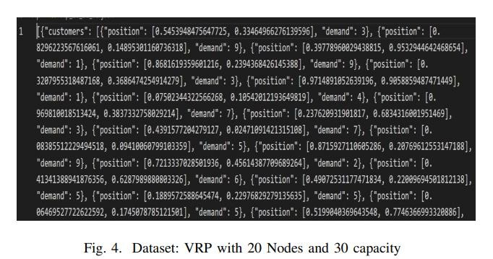
Combinatorial Optimization For Travelling Salesman And Vehicle Routing Problem
An approach for Travelling salesman problem(TSP) and knapsack using reinforcement learning
Methodology proposed is done using graph convolution network-
>multi-layer perceptron->loss function->beam search
Dataset used –

Slide 19
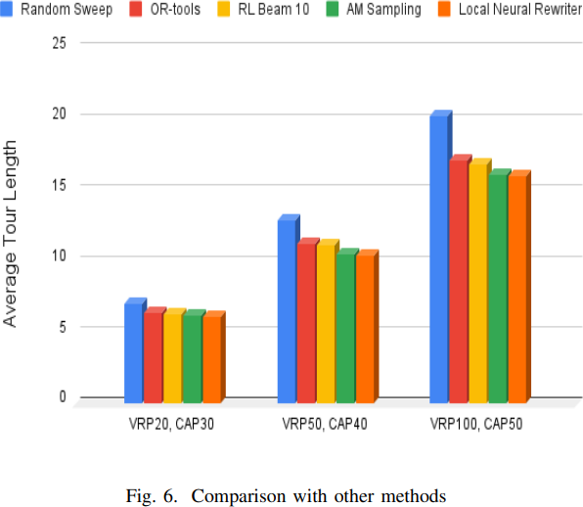
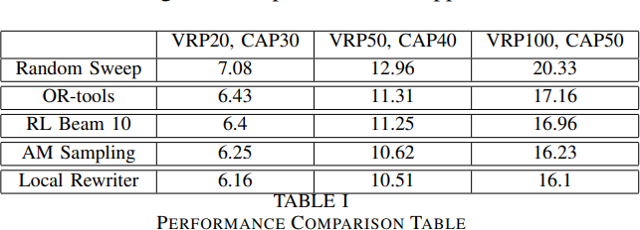
Combinatorial Optimization For Travelling Salesman And Vehicle Routing Problem
Comparison
Then they finally by changing the beam size we test the test data using different searching methods, They tried to findout which algorithm takes the least amount of time, which in their case was greedy search.
Reference: Nagothanekar, Rushikesh & Kharode, Divya & Ghosh, Soma. (2022). Combinatorial Optimization For Travelling Salesman And Vehicle Routing Problem. 1-5. 10.1109/IC3SIS54991.2022.9885540.

Slide 20
Dataset : Real-world VRP benchmark data with realistic constraints - input data and results - v2
This dataset contains 9 Excel (xls) files that can be used as a new benchmark data for the solving of real-world vehicle routing problems with realistic non-standard constraints. All data are real and obtained experimentally by using VRP algorithm on production environment in one of the biggest distribution company in Bosnia and Herzegovina.This dataset also contains 1 additional .csv file which includes real GPS data from vehicle for one day (ROUTE_ID = 5092554, ROUTE_CODE = 24092019) in VRP routing.
The files with description are:
1_master_table_route_settings.xls - contains several basic setting information about the 11 created real-world VRP routes. Each route is uniquely identified by field ROUTE_ID, and all other detail tables have that field. Column with prefix RESULT_ are set during execution of the algorithm.
2_detail_table_customers.xls - this file contains input information about customers who need to be serviced during the delivery of ordered items. Each customer for one route is uniquely identified with field CUSTOMER_CODE.
3_detail_table_vehicles.xls - contains all necessary information about available fleet of vehicles. Each vehicle for one route is uniquely identified with field VEHICLE_CODE. Columns with prefix RESULT_ are set during execution of the algorithm.
4_detail_table_depots.xls - contains all necessary information about available depots for each routing. Each depot for one route is uniquely identified with field DEPOT_CODE.
5_detail_table_constraints_sdvrp.xls - in this file there are all constraints for each od 11 routing which customer (identified by CUSTOMER_CODE) could not be serviced by which vehicles (identified by VEHICLE_CODE) - SDVRP constraints.

Slide 21
Dataset : Real-world VRP benchmark data with realistic constraints - input data and results - v2
6_detail_table_cust_depots_distances.xls - this file contains real distances (travel and time distances) between depots (identified by DEPOT_CODE) and each of the customers (identified by CUSTOMER_CODE) for all routings and reverse between each customer and depots. If in the DIRECTION column is value DEPOT-
>CUSTOMER then the distances are from DEPOT to the CUSTOMER, and in the other way (DIRECTION = CUSTOMER->DEPOT) then the distances are between CUSTOMER and DEPOT. In real environment that distances are not the same. All distances in this file are obtained using GraphHopper API, and OpenStreetMap with included constraints in 9_table_blocked_parts_of_the_road.xls.
7_detail_table_cust_cust_distances.xls - this file contains real distances (travel and time distances) between each of the customers (identified by CUSTOMER_CODE_FROM and CUSTOMER_CODE_TO) mutually for all routings. All distances in this file are obtained using GraphHopper API, and OpenStreetMap with included constraints in 9_table_blocked_parts_of_the_road.xls.. File contains 2 sheets, because of its length.
8_detail_table_routes_RESULTS.xls - this file contains obtained results for each of the 11 routes, by using proposed "Innovative modular approach for solving real-world vehicle routing problems with realistic non- standard constraints".
9_table_blocked_parts_of_the_road.xls - this file is using during the real calculations of distances (travel and time), and contains the blocking parts of the road for all vehicles which must be excluded - because of that roads are not in good state and it is not recommended that the delivery be done through these roads.
10_REAL_GPS_DATA_A08-J-522_24092019.csv - this file includes real GPS data from vehicle for one day (ROUTE_ID = 5092554, ROUTE_CODE = 24092019) in VRP routing. Vehicle = A08-J-522.

Slide 22
Dataset Reference : Žunić, Emir (2019): Real-world VRP benchmark data with realistic constraints - input data and results - v2. Version 2.
4TU.ResearchData. dataset. https://doi.org/10.4121/uuid:6be435d9- c2b4-42e4-a5e2-e683f939b2cb

Slide 23
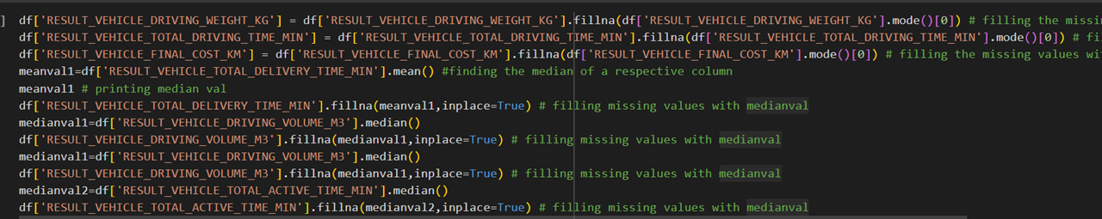
Preprocessing of the data sets

Slide 24
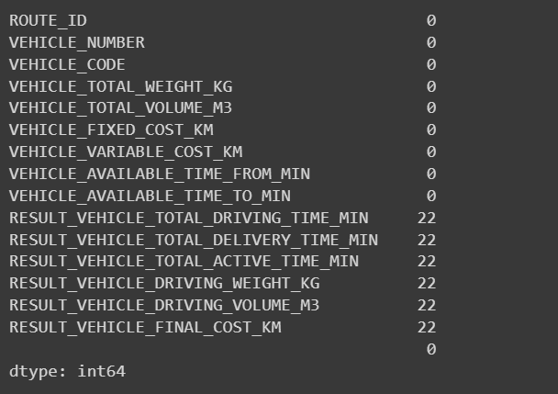
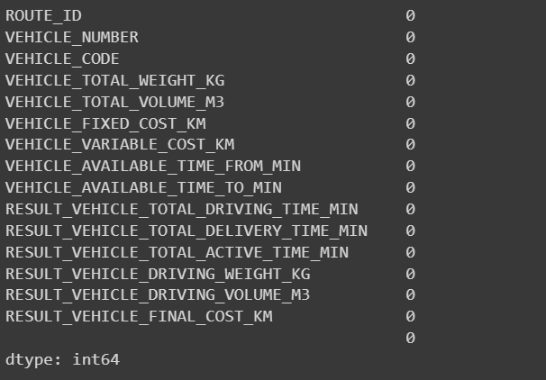
Before Preprocessing
After Preprocessing

Slide 25
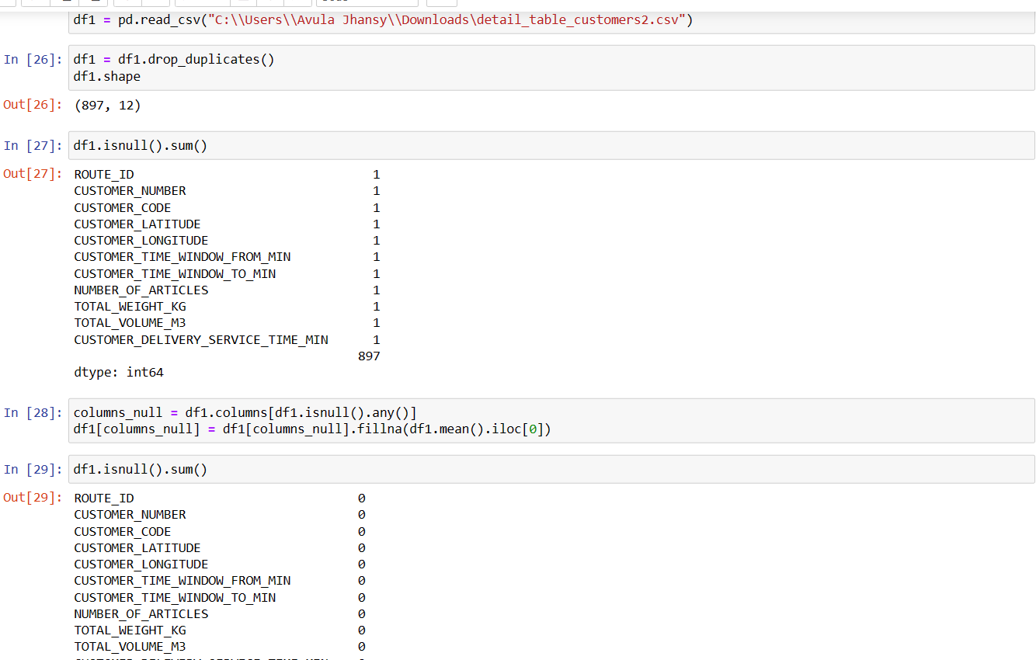
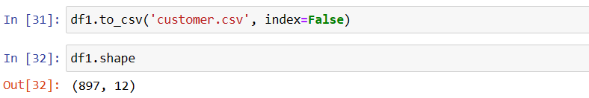
Preprocessing of the data sets
Initially merging was done for all the data sets we have but we got to know that merging is not actually required so we did preprocess for the required data sets which contain null and duplicate values .

Slide 26
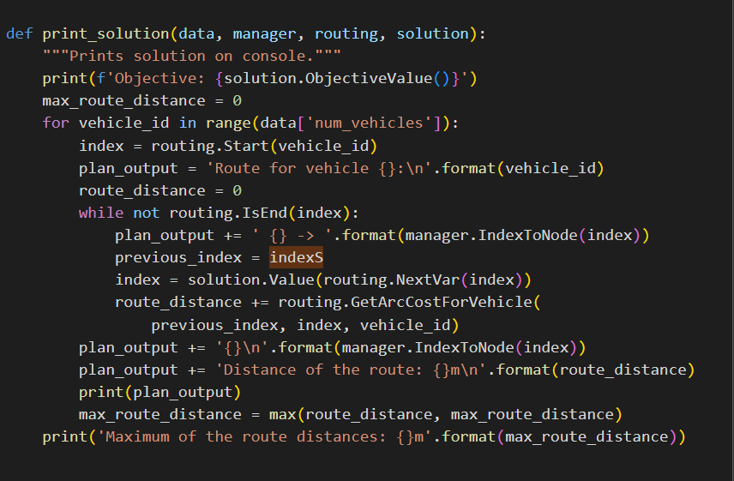
Results and Analysis
Vehicle Routing Problem

Slide 27
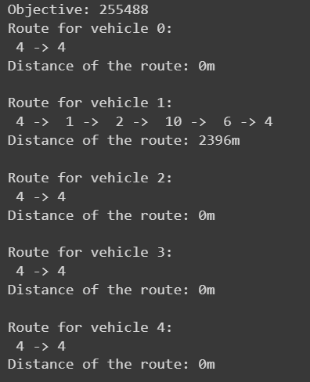
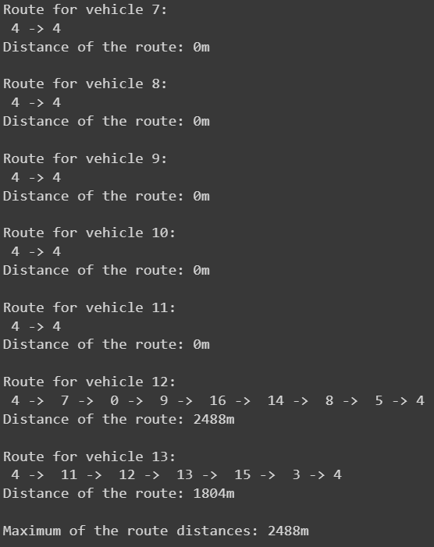
Output

Slide 28
References
1- https://www.mdpi.com/452760
2- https://www.researchgate.net/profile/Shi-Qiang-samuel-Liu/publication/360020711_Deep_reinforcement_learning_for_the_dynamic_and_uncertain_vehicle_routing_problem/links/627333a1973bbb29cc62ff6c/Deep-reinforcement-learning-for-the-dynamic-and-uncertain-vehicle-routing-problem.pdf

Slide 29

THANK YOU
Srinath Vissarapu: srinath.vissarpu_2024@woxsen.edu.in
Hotragn Pettugani: hotragn.pettugani_2024@woxsen.edu.in

